Slide 1
Elevating
Treatment Outcomes
For Patients
NON-CONFIDENTIAL VERSION
© 2025 Elevar Therapeutics, Inc. All Rights Reserved.

Slide 2
Disclaimer
This presentation has been prepared for informational purposes only. No money or other consideration is being solicited, and if sent in response, will not be accepted. This presentation shall not constitute an offer to sell, or the solicitation of an offer to buy, any securities, nor shall there be any sale of these securities in any state or jurisdiction in which such offer, solicitation or sale would be unlawful prior to registration or qualification under the securities laws of any such state or jurisdiction. The Company is not under any obligation to make an offering. It may choose to make an offering to some, but not all, of the people who indicate an interest in investing. The information included in any registration statement will be more complete than the information the Company is providing now and could differ in important ways.
This presentation contains forward-looking statements about Elevar Therapeutics Inc. (“Elevar Therapeutics” or the “Company”). Forward-looking statements are based on our management’s beliefs and assumptions and on information currently available to our management, including those described in the forward-looking statements.
Such statements are subject to known and unknown risks, uncertainties, and other factors that may cause our or our industry’s actual results, levels of activity, performance, or achievements to be materially different from those anticipated by such statements. In some cases, you can identify forward-looking statements by terminology such as “may,” “will,” “should,” “expects,” “plans,” “anticipates,” “believes,” “estimates,” “predicts,” “potential,” “intends,” or “continue,” or the negative of these terms or other comparable terminology. Forward-looking statements contained in this presentation include, but are not limited to, (i) statements regarding the timing of anticipated clinical trials for our product candidates and our research and development programs; (ii) the timing of receipt of clinical data for our product candidates; (iii) our expectations regarding the potential safety, efficacy, or clinical utility of our product candidates; (iv) the size of patient populations targeted by our product candidates and market adoption of our product candidates by physicians and patients; and (v) the timing or likelihood of regulatory filings and approvals.
Except as required by law, we assume no obligation to update these forward-looking statements publicly, or to update the reasons why actual results could differ materially from those anticipated in the forward-looking statements, even if new information becomes available in the future.
The market data and certain other statistical information used throughout this presentation are based on independent industry publications, governmental publications, reports by market research firms or other independent sources. Some data are also based on our good faith estimates. Although we believe these third-party sources are reliable, we have not independently verified the information attributed to these third-party sources and cannot guarantee its accuracy and completeness. Similarly, our estimates have not been verified by any independent source.
By attending or receiving this presentation and viewing the related video, you acknowledge that you will be solely responsible for your own assessment of the market and our market position and that you will conduct your own analysis and be solely responsible for forming your own view of the potential future performance of our business.

Slide 3
Company Overview

Slide 4






















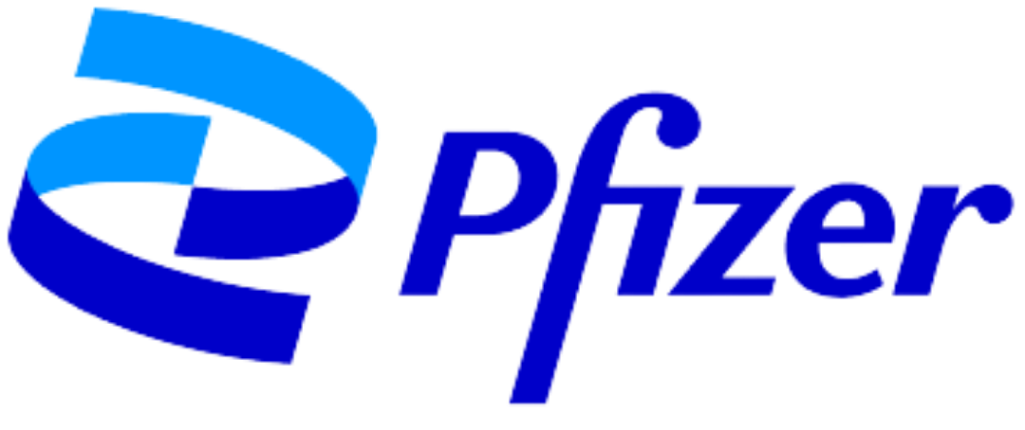


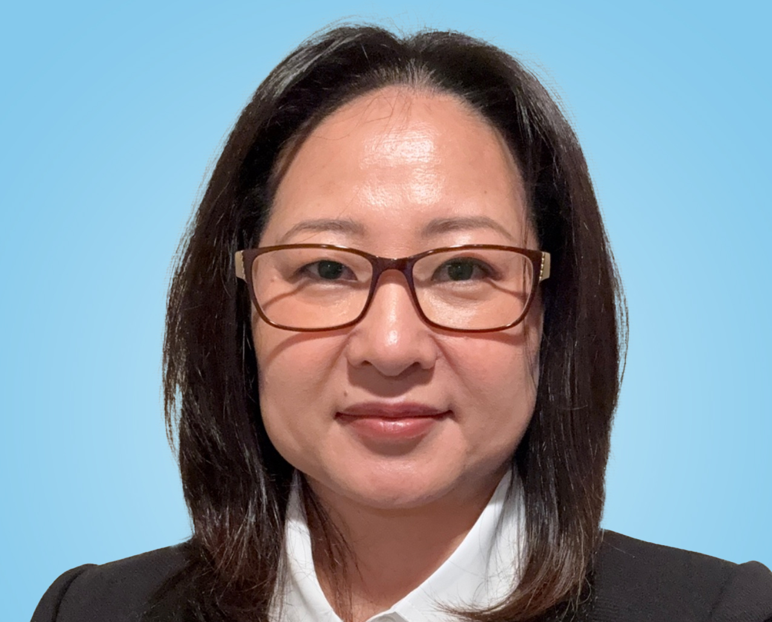




Leadership Team
    Saeho Chong, PhD
    Chief Executive Officer
    Wade Smith
    Chief Financial & Business Officer
    Jacqueline Blazek
    Head, Human Resources
    Chris Galloway, MD
    SVP, Clinical Development/Medical Affairs
    Seong Jang, PhD
    Chief Operating Officer
    Jeanette Bressi
    Head, Corporate Communications
    Dominick DiPaolo
    Sr. Vice President, Quality Assurance
    Michael Palucki
    Sr. Vice President, Manufacturing
    Anna Yim
    Executive Director, Regulatory Affairs
4

Slide 5


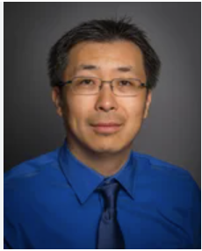

Scientific Advisory Board
Mitesh J. Borad, M.D.
Leader, Novel Therapeutics and
Therapeutic Modalities Program and Getz Family Research Professor
Mayo Clinic
Daneng Li, M.D.
Associate Professor, Department of Medical Oncology & Therapeutics
Research and Leader, Liver Tumors Program and Co-Director of the
Neuroendocrine Tumor Program
City of Hope
Rachna T. Shroff,
MD, MS, FASCO
Professor, Department of Medicine, Chief of the Division of Hematology and Oncology, Medical Director
for the Oncology Service Line,
Associate Dean for Clinical and
Translational Research
University of Arizona College
of Medicine
Richard Kim, M.D.
Service Chief of Medical
Gastrointestinal Oncology & Senior Member in the Gastrointestinal
Oncology Department at Moffitt
Cancer Center Professor of
Oncology
University of South Florida College
of Medicine
5

Slide 6
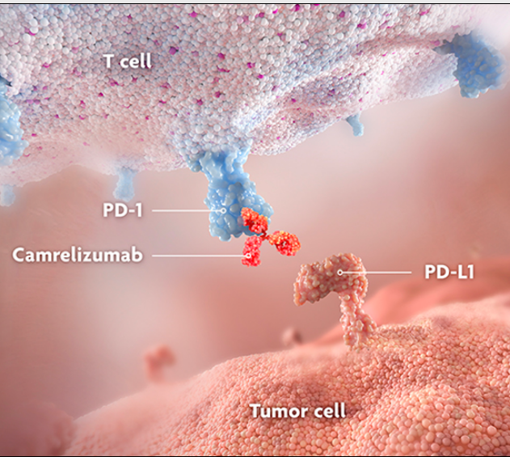
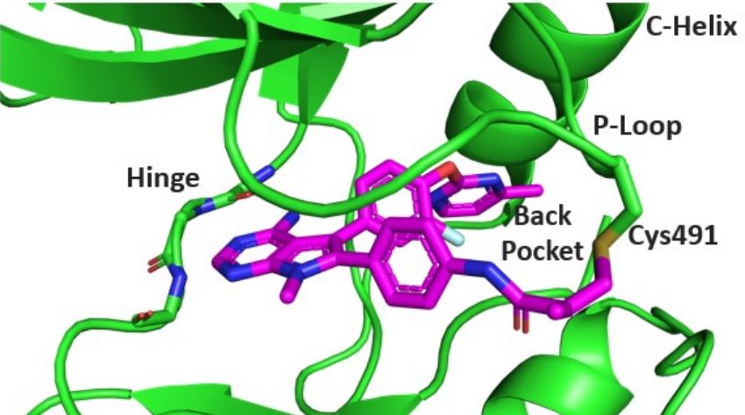
Elevar Therapeutics
An Oncology-Focused, Fully Integrated Biopharmaceutical Company &
Portfolio Company of HLB Company, Ltd.
RIVOCERANIB + CAMRELIZUMAB: 1st Line Systemic Treatment for uHCC
HCC is 2nd leading cause of cancer-related deaths in Asia and the 6th in Western countries⁵
Approximately ~15,577 patients receiving 1L uHCC treatment yearly in the US⁸, with incidence
and mortality rates increasing^{9,} and 60-70% of patients opting for systemic therapy at some point ^{6,7}
CARES-310 study shows mOS of 23.8 months in 1L uHCC* patients, the longest mOS for any treatment in a global Phase 3 trial in uHCC^{1,2}
Current approved combination therapies for uHCC showed mOS of 16.4-19.2 months^{3,4}
Exclusivity on key intellectual property projected through 1H 2038
LIRAFUGRATINIB: Treatment for FGFR2 driven CCA and Tumor Agnostic Fusion
Indications
ReFocus trial demonstrated efficacy improvement compared to current standard of care in 2L CCA with improved safety with low discontinuation rate
Tumor Agnostic Fusions - a first to market opportunity based on patients accrued to date in ReFocus
Encouraging FDA feedback - Breakthrough Drug Designation – Accelerated approval opportunity
Global rights to lirafugratinib for all CCA and tumor agnostic FGFR2 indications through 2040
.
*uHCC - unresectable Hepatocellular Carcinoma
References: 1. Qin S, et al. Lancet. 2023;402(10408):1133-1146. 2. Vogel A et al. Poster presented at: ASCO Annual Meeting; May 31-June 4, 2024; Chicago, IL. J Clin Oncol. 2024;42(16)suppl. Abs 4110. 3. Cheng A-I, et al. J Hepatol. 2022;76(4):862-873. 4. Abou-Alfa GK, et al. NEJM Evid.2022;1(8):doi:10.1056/EVIDoa2100070. 5. Rawla P, et al. Contemp Oncol (Pozn). 2018;22(3):141-150. 6. Llovet JM, et al. Nat Rev Dis Primers. 2021;7(1):6. 7. Yoo JJ, et al. Sci Rep. 2023;13(1):14584. 8. Llovet, J.M., Kelley, R.K., Villanueva, A. et al. Hepatocellular carcinoma. Nat Rev Dis Primers 7, 6 (2021).9. Golabi P, et al. Medicine (Baltimore). 2017;96(9):e5904.
6
Q
Notes:
ANNOTATIONS
Section 1
Successful Phase 3 study/CARES-310 study shows a mOS of 22.1 months in 1L uHCC patients: [Qin 2023/PG2/C2/P2/L1-10; PG3/C1/P2/L1-2]
Current combination therapies for uHCC showed mOS of 16.4-19.2 months: [Cheng 2022/PG864/C2/P3/L1-3]
[Abou-Alfa 2022/PG4/C2/P3/L4-6; PG6/FIGURE1A]
Section 2
15,000+ patients:
41,210 estimated patients diagnosed with liver cancer in 2023: [Siegel 2023/PG20/TABLE 1/L15]
37,089 estimated diagnoses of HCC per year of those patients with liver cancer:
Calculation: 37,089=41,210 with liver cancer X 90% of liver cancer is HCC
90% of cases are HCC: [Llovet 2021/PG1/C1/P1/L4-6]
25,962 estimated cases of uHCC per year:
Calculation: 25,962=37,089 with HCC X 70% of HCC is unresectable
70% of HCC cases are unresectable: [Wang 2017/PG2/C2/P3 ALL]
15,577 estimated cases of uHCC receiving 1L+ treatment per year:
Calculation: 15,577=25,962 with unresectable HCC X 60% undergo systemic treatment
50-60% of HCC exposed to systemic therapy: 60%: [Llovet 2021/PG2/C1/P2/L4-6]
Incidence and mortality: [Golabi 2017/PG1/C2/P2/L3-4]

Slide 7
Regulatory & Development Key Milestones
RIVOCERANIB +
CAMRELIZUMAB
uHCC
BLA/NDA resubmission in September
RIVOCERANIB +
CAMRELIZUMAB
uHCC
PDUFA date – March 20
US commercial launch
planned Mid-2025
EU filing 2H 2025
RIVOCERANIB +
CAMRELIZUMAB
uHCC
EU approval 2H 2026
2024
2025
2026
2027
LIRAFRUGRATINIB
CCA
Pre-NDA Meeting 1H 2025
NDA filing 2H 2025
Confirmatory Phase 3
patient enrollment 2H 2025
Tumor Agnostic:
Additional patient enrollment
2H 2025
LIRAFRUGRATINIB
CCA
Potential U.S. approval
Mid-2026
LIRAFRUGRATINIB
Tumor Agnostic
File sNDA

Slide 8
Rivoceranib, Camrelizumab & Lirafugratinib Have Been Studied in More Than 6,000 Patients Worldwide for Multiple Oncology Indications^{1,2}
Molecule | Therapeutic Area | Indication | Phase 1b | Phase 2 | Phase 3 | NDA Filed | Approved
Rivoceranib + Camrelizumab | Oncology | Unresectable Hepatocellular Carcinoma (uHCC) 1L (Hengrui Collaboration)* |  |  |  |  | PDUFA Date March 20, 2025
Rivoceranib | Oncology | Adenoid Cystic Carcinoma (ACC)* Recurrent or Metastatic
Rivoceranib | Oncology | Gastric Cancer Monotherapy 3L/4L
Lirafugratinib | Oncology | Intrahepatic Cholangiocarcinoma (CCA) with FGFR fusions 2L |  |  |  |  | Planned NDA Filing 2H 2025
Lirafugratinib | Oncology | Tumor Agnostic Fusions
* Elevar Therapeutics and Jiangsu Hengrui Pharma Announce Global Commercialization Licensing Agreement for PD-1 Inhibitor Camrelizumab in Combination with Rivoceranib for uHCC - Elevar Therapeutics
* Orphan Drug Designation (ODD).
All product and company names are trademarks™ or registered® trademarks of their respective holders. Use of them does not imply any affiliation with or endorsement by them.
uHCC=unresectable hepatocellular carcinoma; ACC=adenoid cystic carcinoma; GC=gastric cancer; CRC=colorectal cancer
References: 1. Elevar Therapeutics. Press release. Accessed September 13, 2023. https://elevartherapeutics.com/2023/08/03/elevar-therapeutics-to-host-august-10-virtual-kol-event-on-phase-3-study-of-rivoceranib-in-combination-with-camrelizumab-in-unresectable-hepatocellular-carcinoma-uhcc/ 2. Elevar Therapeutics. Press release. Accessed September 14, 2023. https://elevartherapeutics.com/2023/07/17/elevar-therapeutics-announces-fda-acceptance-
for-filing-of-new-drug-application-for-rivoceranib-in-combination-with-camrelizumab-as-a-first-line-treatment-for-unresectable-hepatocellular-carcinoma/
Notes:
ANNOTATIONS
More than 6,000 patients: [Elevar Therapeutics to Host_Elevar website/PG4/P1/L5-6] [Elevar Therapeutics Announces FDA Acceptance_Elevar website/PG4/P1/L2-3]
Indications: [Elevar Therapeutics to Host_Elevar website/PG3/P4/L4-7; PG4/P1/L1-3] [Elevar Therapeutics Announces FDA Acceptance_Elevar website/PG3/P6ALL]

Slide 9
Near-Term Pipeline Programs
Camrelizumab + Rivoceranib
First line Unresectable Hepatocellular Carcinoma
March 2025 NDA/BLA PDUFA Date

Slide 10
Camrelizumab and Rivoceranib are Proven Therapies with Large Commercial Opportunities
COMMERCIAL PRODUCTS AVAILABLE OUTSIDE US
Rivoceranib
    Commercialized by Hengrui Pharma in China as Apatinib®
    Approved in China for:
      Gastric cancer 1L monotherapy (2014)
      Advanced hepatocellular carcinoma (HCC) 2L monotherapy (2020)
      Unresectable hepatocellular carcinoma (uHCC) in combination with Hengrui Pharma’s camrelizumab 1L (January 2023)
    Small molecule, TKI selective for the VEGF receptor, orally administered
    Elevar has global rights to rivoceranib (excluding Greater China and Korea)
Camrelizumab and rivoceranib are being developed for HCC and uHCC – areas of large unmet medical need representing a
$10B+ global potential market opportunity
Camrelizumab
    Commercialized by Hengrui Pharma in China as AiRuiKa®
    One of the top-selling anti-PD-1s in China with eight approved indications; administered by IV infusion
    Elevar has global rights to camrelizumab for HCC with ability to add indications (excluding Greater China and Korea)
10

Slide 11

Hepatocellular Carcinoma Systemic Therapy Paradigm¹
UNRESECTABLE HCC
Child-Pugh A or B ECOG PS 0-2
Child-Pugh C ECOG PS 3+
First-Line
Systemic Therapy
Best
Supportive Care
Child-Pugh A
Child-Pugh B
Sorafenib*
MOA | OS | PFS | Safety (TRAE Discontinuation Rates)
Atezolizumab (PD-L1 inhibitor) in combination with bevacizumab (VEGF inhibitor) | 19.2 months (95% CI,17.0-23.7) P <.001 [HR 0.66 (95% CI, 0.52-0.85)] | 6.9 months (95% CI, 5.7-8.6) P <.001 [HR 0.65 (95% CI, 0.53-0.81)] | 7% (both components)
Durvalumab (PD-L1 blocking antibody) in combination with tremelimumab-actl (CTLA-4 inhibitor) | 16.4 months (95% CI, 14.16-19.58) P =.0035 [HR 0.78 (96.02% CI, 0.65-0.93)] | 3.8 months Not significantly different [HR 0.90 (95% CI, 0.77-1.05)] | 13.7%
Camrelizumab (PD-1 inhibitor) in combination with rivoceranib (TKI) | 23.8 months (95% CI, 20.61-27.2) P <.0001 [HR 0.64 (95% CI, 0.52-0.79)] | 5.6 months (95% CI, 5.5-7.43) P <.0001 [HR 0.54 (95% CI, 0.44-.67)] | 4.4% (both components)
Sorafenib/Lenvatinib
Atezolizumab plus Bevacizumab^{2,3}
Durvalumab plus Tremelimumab⁴
Camrelizumab plus Rivoceranib^{5,6}
*Per NCCN Guidelines for 1L uHCC, nivolumab and atezolizumab+bevacizumab are useful in certain circumstances (Child-Pugh Class B only).
References: 1. Leowattana W, et al. World J Gastroenterol. 2023;29(10):1551-1568. 2. Cheng A-I, et al. J Hepatol. 2022;76(4):862-873. 3. Finn RS, et al. N Engl J Med. 2020;382(20):1894-1905.
4. Abou-Alfa GK, et al. NEJM Evid. 2022;1(8):doi: 10.1056/EVIDoa2100070 5. Qin S, et al. Lancet. 2023;402(10408):1133-1146. 6. Vogel A et al. Poster presented at: ASCO Annual Meeting; May 31-June 4, 2024; Chicago, IL. J Clin Oncol. 2024;42(16)suppl. Abs 4110.
Notes:
ANNOTATIONS
Slide had solo reference:
New Drug Report (IDP Analytics, October 2023)
Since this reference was unavailable, new references added to slide
ANNOTATION for Figure (top and left side of slide):
Leowattana 2023/PG1559/FIGURE1
Note: Camrelizumab plus rivoceranib is NOT in Figure 1, as this drug combination is not yet approved (included as forward-thinking)
ANNOTATIONS for blue table (Atezo plus beva):
MOA: Cheng 2022/PG863/C1/P3/L1-5
OS: Cheng 2022/PG864/C2/P3/L1-3
PFS: Cheng 2022/PG864/C2/P4ALL
Safety: Finn 2020/PG1901/C2/P1/L17-21
ANNOTATIONS for blue table (Durva plus treme):
MOA: Abou-Alfa 2022/PG2/C1/P4/L4-5
OS: Abou-Alfa 2022/PG4/C2/P3/L4-6; PG6/FIGURE1A; STRIDE defined: Abou-Alfa 2022/PG2/C1/P4/L4-7
PFS: Abou-Alfa 2022/PG6/FIGURE1B; STRIDE defined: Abou-Alfa 2022/PG2/C1/P4/L4-7
Safety: Abou-Alfa 2022/PG9/TABLE3
ANNOTATIONS for blue table (Cam plus rivo):
MOA: Qin 2023/PG2/C2/P5/L1-4
OS: Qin 2023/PG6/C2/P3/L3-9
PFS: Qin 2023/PG6/C2/P1/L5-10
Safety: Qin 2023 supplemental appendix/PG15/TABLES9/L2

Slide 12
Camrelizumab + Rivoceranib Demonstrated Notable mOS vs Sorafenib as First-Line Treatment for unresectable Hepatocellular Carcinoma (uHCC)
PD-1 + TKI^{7, 8}
PDL-1 + VEGF^{5,6}
TKI
PDL-1 + CTLA-4 ^{3, 4}
2
MEDIAN OVERALL SURVIVAL (OS) (MONTHS)
Please note that head-to-head studies were not conducted between these products or compounds.
These data are for information purposes only and no comparative claims of non-inferiority or superiority in terms of efficacy or safety are implied or intended.
1
References: 1. NEXAVAR. Prescribing Information. Whippany, NJ: Bayer HealthCare Pharmaceuticals Inc; July 2020. 2. LENVIMA [package insert]. Nutley, NJ: Eisai Inc. 3. IMFINZI (durvalumab) [Prescribing Information]. Wilmington, DE: AstraZeneca Pharmaceuticals LP; 2022. 4. IMJUDO (tremelimumab-actl) [Prescribing Information]. Wilmington, DE: AstraZeneca Pharmaceuticals LP; 2022. 5. TECENTRIQ (atezolizumab) (Prescribing Information). South San Francisco, CA: Genentech; 2024. 6. AVASTIN (bevacizumab) (Prescribing information. South San Francisco, CA: Genentench, Inc.; May 2022. 7. Qin S, et al. Lancet. 2023;402(10408):1133-1146. doi:10.1016/S0140-6736(23)00961-3; 8. Vogel A et al. Poster presented at: ASCO Annual Meeting; May 31-June 4, 2024; Chicago, IL. J Clin Oncol. 2024;42(16)suppl. Abs 4110
LENVIMA is a registered trademark of Eisai Inc. NEXAVAR is a registered trademark of Bayer; IMFINZI and IMJUDO are registered trademarks of the AstraZeneca group of companies; TECENTRIQ & AVASTIN are registered trademarks of Genentech, Inc..
12

Slide 13
Camrelizumab + Rivoceranib Has the Potential to be a Best-in-Class Treatment Option in uHCC Based on Measurable, Clinically Relevant Data
Median Overall Survival (mOS) | 23.8 months^{1,2}
Median Progression Free Survival (mPFS) | 5.6^{1,2} HR, 0.54 (95% CI; 0.44-0.67)
Stable Disease (SD) | 51.1%^{1,2}
Progressive Disease (PD) | 16.5%^{1,2}
Viral and Non-Viral Etiology | 55% and 29% reduction in the risk for mortality for patients with HCV and non-viral etiology, respectively^{1,2}
Albumin-Bilirubin (ALBI) Impact Post-Hoc analysis | No significant change over time to ALBI Score^{1,2} Similar mOS for patients with Grade 1 or Grade 2 ALBI Score³
Discontinuation Rate | 4.4%^{1,2}
Grade 3-4 Hemorrhage | 3.3% rate¹
Half-life (mean, steady state) | Rivoceranib: 7.0 hours to 16.3 hours⁴ (allows for rapid elimination of VEGFR blockade) Camrelizumab: 17 days⁵
1. Qin S, et al. Lancet. 2023;402(10408):1133-1146. 2. Vogel A et al. Poster presented at: ASCO Annual Meeting; May 31-June 4, 2024; Chicago, IL. J Clin Oncol. 2024;42(16)suppl. Abs 4110. 3. Vogel A, et al. J Clin Oncol. 2024;42(3 suppl):abstract 509. 4. Data on file. 0007. Fort Lee, NJ: Elevar Therapeutics; February 14, 2024. 5. Data on file. 0008. Fort Lee, NJ: Elevar Therapeutics; February 14, 2024.
Notes:
ANNOTATIONS
mOS: [Qin 2023/PG6/C2/P3/L3-8]
Relative risk (PFS): [Qin 2023/PG6/C2/P1/L5-10; calculation of 48%=1-0.52X100=48%]
Stable disease: [Qin 2023 Supplemental appendix/PG10/TableS6]
Progressive disease: [Qin 2023 Supplemental appendix/PG10/TableS6]
Viral and non-viral: [Qin 2023/PG8/FIG3B/L Aetiology/Hepatitis C virus HR=0.45;
calculation: 1-0.45X100=55%; Non-viral HR=0.71; calculation: 1-0.71X100=29%]
ALBI no significant: [Qin 2023/PG10/C2/P1/L3-4]
ALBI similar OS: [Vogel 2024/PG1/FIGURE 1A and FIGURE 1B/C2/L2]
Discontinuation: [Qin 2023/Supplemental appendix/PG15/TableS9]
Hemorrhage: [Qin 2023/Supplemental appendix/PG18/TableS12]
Half-life:
Rivoceranib: [Data on file. 0007. Fort Lee, NJ: Elevar Therapeutics; February 14, 2024/PG13/Elimination section/ALL]
Camrelizumab: [Data on file. 0008. Fort Lee, NJ: Elevar Therapeutics; February 14, 2024/PG24/P1/L5]

Slide 14
mOS 23.8 Months at Final Study Analysis¹
OS: FINAL ANALYSIS ^{1, 2}
100
23.8 months
75
76.6%
Cam + Rivo
n = 272
Sorafenib
n = 271
60.9%
No. of events (%) | 159 (59) | 192 (71)
Median OS, months (95% CI) | 23.8 (20.6-27.2) | 15.2 (13.2-18.5)
OS (%)
50
49.0%
15.2 months
37.7%
25
32.6%
24.8%
Stratified HR, 0.64 (95% CI, 0.52-0.79)ª, p < 0.0001^{b}
0
0
2
4
6
8
10
12
14
16
18
20
22
24
26
28
30
32
34
36
38
40
42
44
46
Time (months)
No. at risk
Camrelizumab + rivoceranib | 272 | 265 | 250 | 231 | 224 | 215 | 204 | 193 | 172 | 156 | 147 | 136 | 124 | 111 | 94 | 73 | 49 | 35 | 24 | 19 | 15 | 3 | 1 | 0
Sorafenib | 271 | 268 | 232 | 214 | 198 | 171 | 158 | 138 | 126 | 118 | 108 | 94 | 83 | 78 | 70 | 55 | 43 | 34 | 21 | 14 | 9 | 2 | 0
The stratification factors were the randomization strata.
There was very early and durable separation in the KM curves for Cam/Rivo vs Sorafenib.
CI=confidence interval; HR=hazard ratio; ITT=intent to treat; OS=overall survival.
ªStratified Cox proportional hazards model. ^{b}One-sided based on the stratified log-rank test.
1. Vogel A et al. Poster presented at: ASCO Annual Meeting; May 31-June 4, 2024; Chicago, IL. J Clin Oncol. 2024;42(16)suppl. Abs 4110.
2. Qin S, et al. Lancet. 2023;402(10408):1133-1146.

Slide 15
OS Favored Camrelizumab + Rivoceranib Across Most Subgroups
OS by Prespecified Subgroups
Geographical region
ª | 134/225 | 160/224 | 0.68 (0.54-0.85)
^{b} | 25/47 | 32/47 | 0.58 (0.34-1.00)
Race
 | 135/226 | 160/224 | 0.68 (0.54-0.85)
 | 24/44 | 32/46 | 0.55 (0.32-0.95)
ECOG performance status
 | 65/120 | 75/116 | 0.70 (0.50-0.98)
 | 94/152 | 117/155 | 0.63 (0.48-0.83)
Alpha-fetoprotein at baseline
 | 90/176 | 112/171 | 0.65 (0.50-0.86)
 | 69/96 | 80/100 | 0.68 (0.49-0.93)
Barcelona Clinic Liver Cancer stage
 | 20/38 | 20/40 | 1.06 (0.57-1.97)
 | 139/234 | 172/231 | 0.62 (0.49-0.77)
Overall^{c} | 159/272 | 192/271 | 0.64 (0.52-0.79)
FINAL ANALYSIS
Cam + Rivo
n = 272
Sorafenib
n = 271
Unstratified HR
(95% CI)
OS favored cam+rivo
across most subgroups
reported in the final
analysis
Favors cam + rivo
Favors sorafenib
CI=confidence interval; ECOG=Eastern Cooperative Oncology Group; HR=hazard ratio; US=United States.
ªIncludes mainland China, Hong Kong, Taiwan, and South Korea; ^{b}Includes Belgium, Italy, Germany, Poland, Russia, Spain, Turkey, Ukraine, and the US; ^{c}Stratified HR.
Vogel A et al. Poster presented at: ASCO Annual Meeting; May 31-June 4, 2024; Chicago, IL. J Clin Oncol. 2024;42(16)suppl. Abs 4110.

Slide 16
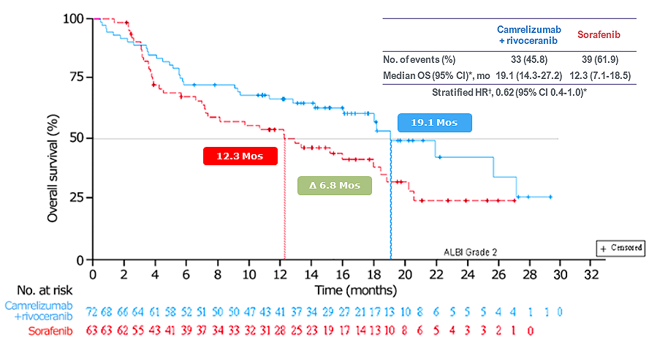
Subgroup Interim Analysis: CARES-310
OS SUBGROUP ANALYSIS¹
ALBI Grade 2²
ng/mL
ng/mL
OS outcomes favored the cam + rivo arm regardless
of baseline ALBI scores
  HR 0.62 (0.47-0.83) for ALBI grade 1
  HR 0.62 (0.4-1.0) for ALBI grade 2
*Cox proportional hazards model.
References: 1. Qin S, Chan SL, Gu S, et al. Lancet. 2023;402(10408):1133-1146. 2. Vogel A, et al. J Clin Oncol. 2024;42(3 suppl):abstract 509.
16

Slide 17
Final Analysis — Safety¹
TABLE 2. TRAEs
Cam + Rivo (n=272)
Sorafenib (n=269)
 | Cam + Rivo (n=272) |  | Sorafenib (n=269)
 | ANY GRADE | GRADE ≥3 | ANY GRADE | GRADE ≥3
Hypertension | 189 (69.5) | 104 (38.2) | 117 (43.5) | 40 (14.9)
AST increased | 149 (54.8) | 47 (17.3) | 101 (37.5) | 14 (5.2)
Proteinuria | 135 (49.6) | 16 (5.9) | 73 (27.1) | 5 (1.9)
ALT increased | 129 (47.4) | 38 (14.0) | 81 (30.1) | 8 (3.0)
Platelet count decreased | 126 (46.3) | 32 (11.8) | 90 (33.5) | 4 (1.5)
Blood bilirubin increased | 117 (43.0) | 24 (8.8) | 75 (27.9) | 4 (1.5)
PPE syndrome | 102 (37.5) | 33 (12.1) | 164 (61.0) | 42 (15.6)
Diarrhoea | 84 (30.9) | 6 (2.2) | 106 (39.4) | 14 (5.2)
RCCEP | 82 (30.1) | 8 (2.9) | 0 | 0
Neutropil count decreased | 75 (27.6) | 16 (5.9) | 28 (10.4) | 3 (1.1)
White blood cell count decreased | 74 (27.2) | 7 (2.6) | 38 (14.1) | 4 (1.5)
GGT increased | 65 (23.9) | 26 (9.6) | 49 (18.2) | 19 (7.1)
Hypothyroidism | 58 (21.3) | 0 | 17 (6.3) | 0
Fatigue | 56 (20.6) | 8 (2.9) | 21 (7.8) | 1 (0.4)
Safety data aligned with the interim OS analysis,¹ with no new signals noted. TRAE led to discontinuation of
camrelizumab in 17.6%, rivoceranib in 16.9% and 4.4% in the combo arm.
Discontinuation rate of both agents was low, at 4.4%. Sorafenib was discontinued in 4.8% due to TRAE.
Vogel A et al. Poster presented at: ASCO Annual Meeting; May 31-June 4, 2024; Chicago, IL. J Clin Oncol. 2024;42(16)suppl. Abs 4110Data are n (%). *TRAE=treatment adverse event, s of any grade occurring in ≥20% or of grade≥3 occurring in ≥5% of patients in either group are listed. AST. Aspartate aminotransferase; ALT=alanine aminotransferase; GGT, Gamma-glutamyltransferase; PPE, palmar-plantar erythrodysaesthesia; RCCEP, reactive cutaneous capillary endothelial proliferation

Slide 18
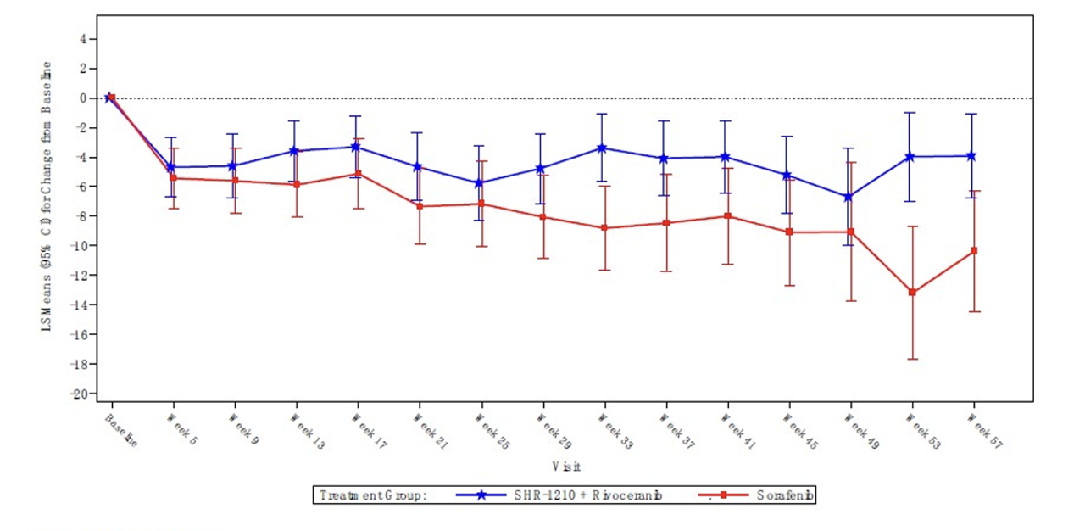
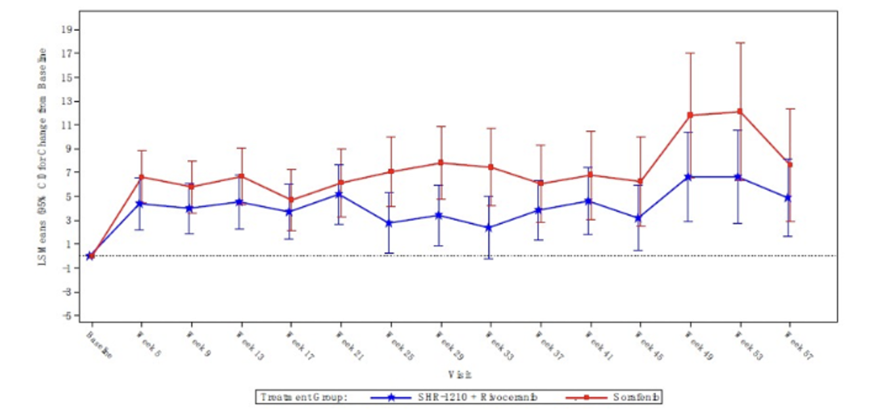
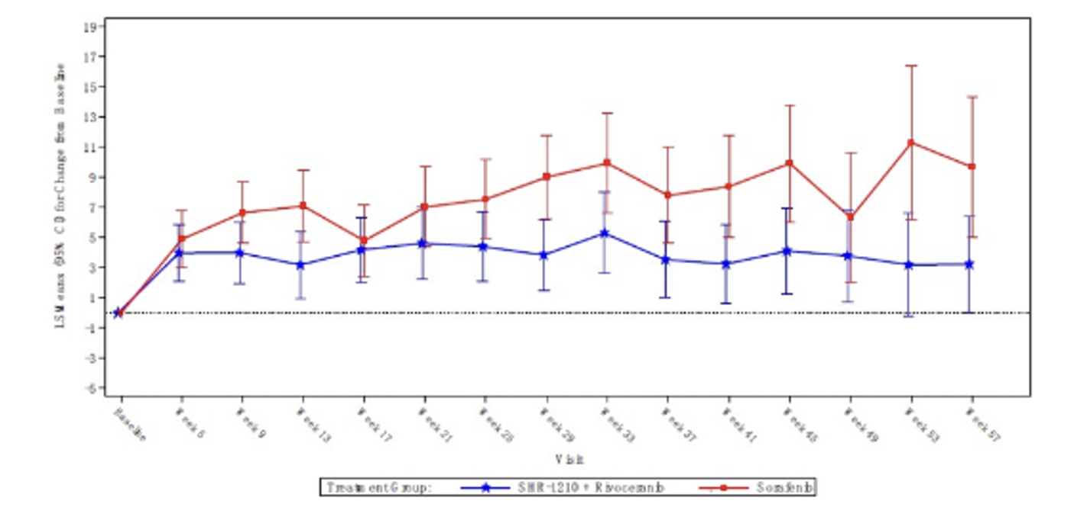
Camrelizumab + Rivoceranib
Patient-Reported Outcomes¹
Camrelizumab + rivoceranib demonstrated statistically significant differences in patient-reported outcomes vs sorafenib:
Less deterioration in global health status/quality
of life (P=0.012)
Decreased pain (P=0.045)
Decreased fatigue (P=0.007)
LS Mean (95% CI) for Change from Baseline in
Global Health Status/Quality of Life Over Time By Treatment Arm*
LS Mean (95% CI) for Change from Baseline
in Pain Over Time By Treatment Arm†
LS Mean (95% CI) for Change from Baseline
in Fatigue Over Time By Treatment Arm†
CI=confidence interval; EORTC=European Organization for Research and Treatment of Cancer; LS=least squares; QLQ-C30=Quality-of-life Questionnaire Core 30.
*Measured by EORTC QLQ-C30 using data up to week 57. An increase in scores from baseline indicates improvement.
†Measured by EORTC QLQ-C30 using data up to week 57. A decrease in scores from baseline indicates improvement.
Reference: 1. Data on file. 0004. Fort Lee, NJ: Elevar Therapeutics; February 12, 2024.
18

Slide 19
Near-Term Pipeline Programs
Lirafugratinib
Second Line Intrahepatic Cholangiocarcinoma with FGFR2 Fusions
Second Line Tumor Agnostic FGFR2 Fusions

Slide 20




Lirafugratinib
Potential best-in-class efficacy for FGFR2 CCA with ongoing clinical development in tumor agnostic indication with FGFR2 driven fusions, mutations and amplifications
Lirafurgatinib efficacy demonstrates improvement compared
to current standard of care across multiple indications and
improved safety with low discontinuation rate
Updated CCA, tumor agnostic and indication-specific
data highlight lirafugratinib’s continued development
progress, particularly with encouraging FDA feedback on
CCA and tumor agnostic fusion indications
Lirafurgatinib provides potential for global first to
market opportunity across high-need solid tumors

Slide 21
Clinical Trial Endpoint Comparisons
Lirafugratinib — Strong Data in FGFR2 Fusions CCA and Tumor Agnostic Solid Tumors
INDICATIONS:
CCA FGFR2 Fusions
Tumor Agnostic FGFR2 Fusions
(Excluding CCA)
 | Cam + Rivo (n=272) | Sorafenib (n=269)
N | 116 | 47*
ORR, n (%) | 60 (52%) | 17 (37%)
DoR, median months | 9.2 | 7.3
DoT, median months | 9.2 | 3.7
Prior LoT, median | 1 | 2
OS, median months | 25.4 | 13.6
Lirafugratinb
(2L)
2L+ SoC
Regimen(s) | Pemigatinib, futibatinib | No Standard of Care
ORR (%) | 36 – 42% | —
DoR, median months | 9.1 – 9.7 | —
Prior LoT, median | ≥1 | —
OS, median months | 17.5 – 21.7** | —
1. Alterations include fusions, amplifications, and mutations.
ORR: Objective Response Rate; DoR: Duration of Response; DoT: Duration of Therapy; LoT: Line of Therapy; SoC: Standard of Care.
*N=46 response evaluable
** pemi ESMO GI 2022, futi NEJM 2023
Refocus preliminary data as of 06/26/2024 ClinicalTrials.gov ID NCT04526106

Slide 22
REFOCUS Trial Results
COMMERCIAL PRODUCTS AVAILABLE OUTSIDE US
Lirafugratinib TEAEs
Futibatiniib
Pemigatinib
 |  |  | Sorafenib (n=269) |  | Sorafenib (n=269)
Parameter | 70 mg QD (N=385) |  | 20 mg QD (N=103) |  | 13.5 mg QD 2 wks on / 1 wk off (N=146)
Grade | Any | Gr 3+ | Any | Gr 3+ | Any | Gr 3+
Any | 100% | 62% | 100% | 77% (5% Gr 5) | NR | 64%
Nail toxicities | 73% | 7.5% | 47% | 2% | ≥43%³ | ≥4%⁴
Stomatitis | 66% | 12% | 30% | 6% | 29% | 5%
PPE | 65% | 19% | 21% | 5% | 11% | 4%
Dry Mouth | 46% | 0% | 35% | 0% | 35% | 0%
Alopecia | 40% | 0% | 34% | 0% | 49% | 0%
Fatigue | 32% | 2% | 37% | 8% | 38% | 5%
Constipation | 29% | 0.5% | 39% | 0% | 34% | 1%
RPED | 29% | 2% | 7.8% | NR | 0% | 0%
Dry Skin | 28% | 0.3% | 29% | 0% | 19% | 1%
Dysgeusia | 27% | 0.5% | 25% | 0% | 40% | 0%
Dry eye | 27% | 0.3% | 25% | 1% | 25% | 1%
Hyperphosphatemia | 20% | 0% | 85% | 30% | 60% | 0%
Diarrhea | 18% | 0.8% | 39% | 1% | 44% | 3%
Increased ALT | 14% | 4% | 50% | 7% | 5% | 2%
Increased AST | 13% | 3% | 46% | 13% | 4% | 3%
Lirafugratinib
TEAEs
(≥25%¹)
Strong Data in FGFR2 Fusions CCA and Tumor Agnostic Solid Tumors
All cause TEAEs
Futibatinib and Pemigatinib are both approved for FGFR2 fusions/ rearrangements
in CCA
Key
TEAEs
ClinicalTrials.gov ID
NCT04526106
22

Slide 23
Lirafugratinib — Illustrative Near-Term Clinical Development Plans
FDA FEEDBACK
2025
2026
2027
2028
 | 2024 | 2025 | 2026 | 2027 | 2028
Encouraged NDA
submission for CCA upon data maturity and recommended requesting a pre-NDA meeting to review top-line results
Pre-NDA Meeting
NDA Approval*
Full approval path
To be determined at a pre-NDA
meeting; futi precedent was based on existing data showing equal
efficacy and better safety at
a lower dose, and it is possible
Lirafugratinib avoids this situation.
CCA
RCT in 2L CCA at two different doses N=~100
(similar to futi precedent)
Follow existing pt cohort for OS and PFS
Agreed that preliminary clinical
data warrant further exploration
Emphasized need for larger clinical
dataset (additional patients across
tumor types) for filing, though
would not commit to a specific
number of patients
Encouraged targeting an sNDA
submission, after CCA approval, upon maturity ofadditional relevant data
Enroll additional tumor agnostic
patients (N=30 – 50)
TUMOR AGNOSTIC
FUSIONS
File sNDA
sNDA Approval*
23

Slide 24
Commercial Opportunity
& Strategy

Slide 25
Elevar Is Well Positioned to Treat the US uHCC Patient Population
Estimated patients diagnosed with liver cancer in 2023 (incidence)
Estimated diagnoses of HCC per year
Estimated cases of uHCC per year
Estimated cases of uHCC receiving 1L+ treatment per year
Estimated cases of uHCC receiving 2L+
treatment per year
41,210¹
37,089²
25,962³
~15,577²
4,985^{4*}
Patients electing to not undergo
further treatment, or mortality
Patients not electing
to undergo treatment
Resectable (or
transplantable) cases
*Interpret with caution. Progression rate from 1L to 2L not well-established.
Camrelizumab + Rivoceranib Target Market
Cholangiocarcinoma (bile duct cancer) patients
References: 1. Siegel RL, et al. CA Cancer J Clin. 2023;73(1):17-48. 2. Llovet JM, et al. Nat Rev Dis Primers. 2021;7(1):6.
3. Wang EA, et al. Int J Clin Pract. 2017;71(11). 4. Klink AJ, et al. Oncologist. 2022;27.
Notes:
ANNOTATIONS
41,210: [Siegel 2023/PG20/TABLE 1]
37,089: Calculation: 37,089=41,210 with liver cancer X 90% of liver cancer is HCC 41,210: [Siegel 2023/PG20/TABLE 1] ~90% of cases are HCC: [Llovet 2021/PG1/C1/P1/L4-6]
25,962: Calculation: 25,962=37,089 with HCC X 70% of HCC is unresectable 37,089: [SEE ANNOTATION FOR CALCULATION OF 37,089] ~70% of HCC cases are unresectable: [Wang 2017/PG1/ABSTRACT/L4-5]
15,577: Calculation: 15,577=25,962 with unresectable HCC X 60% undergo systemic treatment 25,962: [SEE ANNOTATION FOR CALCULATION OF 25,962] ~60% of HCC cases are unresectable: 60%: [Llovet 2021/PG2/C1/P2/L4-7]
4,985: Calculation: 4,985=15,577 with unresectable HCC receiving systemic treatment X 32% receive 2L 15,577: [SEE ANNOTATION FOR CALCULATION OF 15,577] -32% of receive 2L: [Klink 2022/PGe267/C1/P2/L1, 4-5] Calculation: 32%=90 2L patients/284 total patients X 100

Slide 26
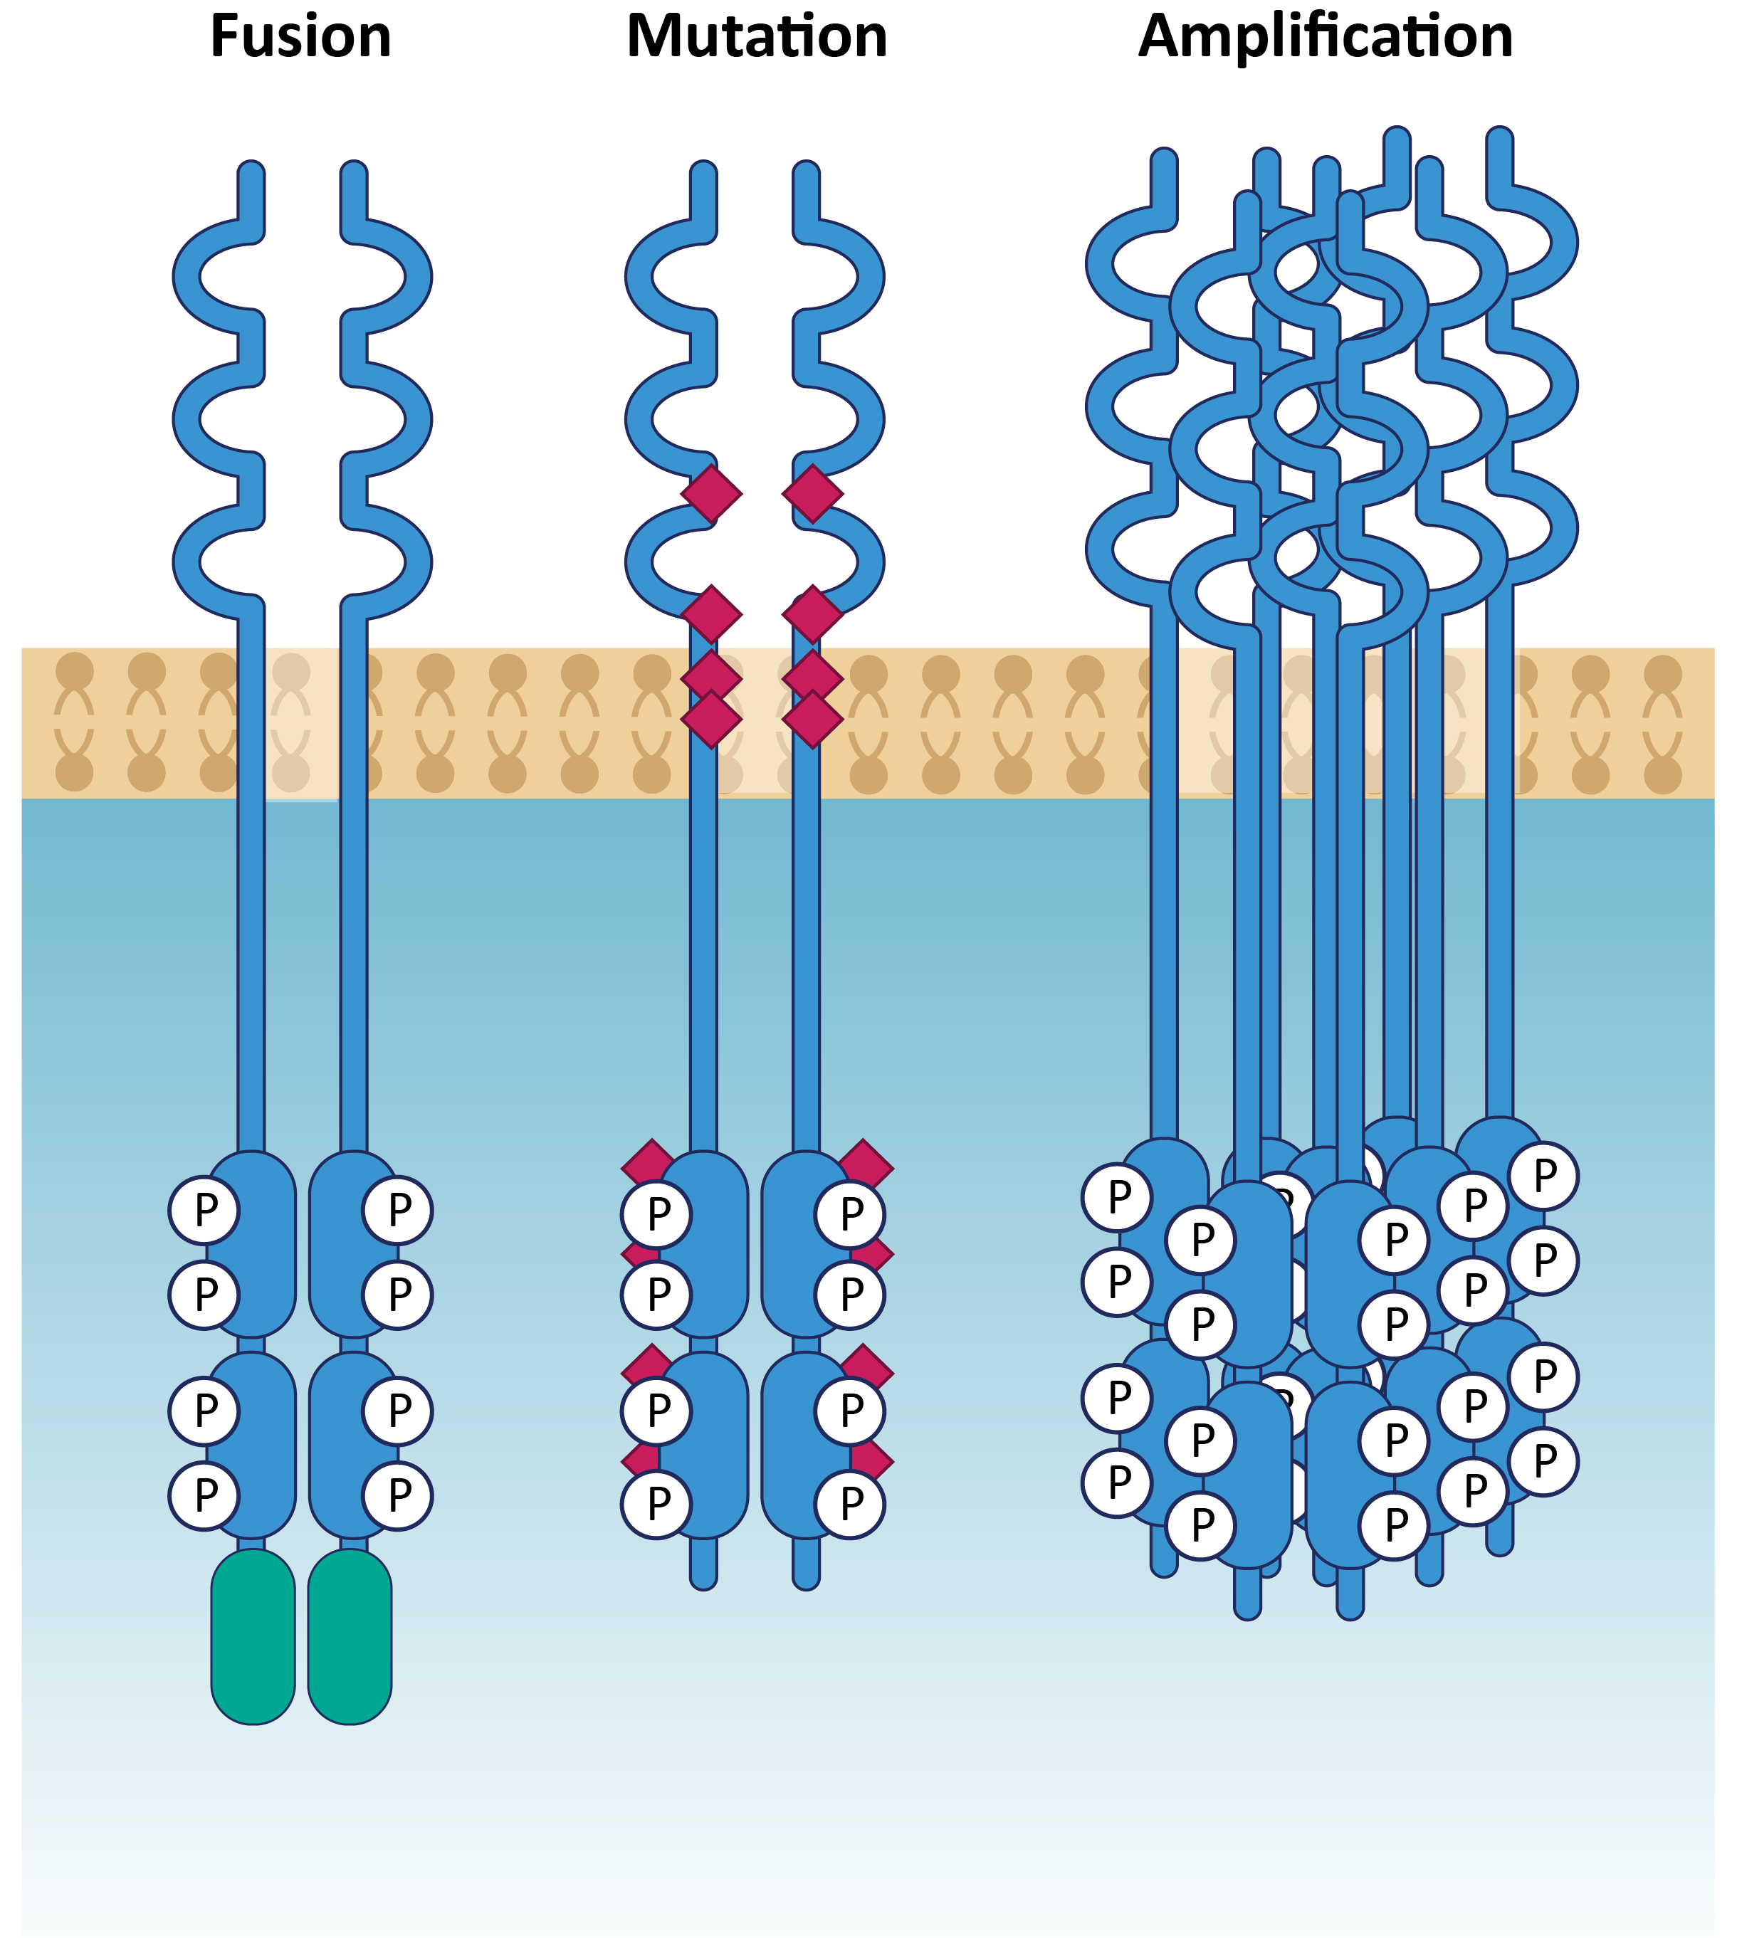
FGFR2 — Validated Target Present in Several Tumor Types
Three classes of driver
alterations in FGFR2
FGFR2 alterations are observed across multiple tumor types²
FGFR2 Annual Cases
(US, comprehensive)
Total FGFR2 alterations¹:
~11-35K patients
Breast
CUP
Endometrial
Cholangio
Stomach
Skin Melanoma
Lung
Bladder
Pancreatic
~4.5K-14K
~6.5K-21K
Ovarian
Annual US Patient Count¹
Fusions³
Amplifications
Mutations
Sources: Image adapted from Babina IS, Turner NC. Nat Rev Cancer 2017;17: 318-332; Internal analysis based on third party industry data
1. All patient #’s refer to total annual number of US patients with late-line cancers vs. comprehensive annual incidence that may be amenable to treatment with our programs including additional FGFR gene fusions and rearrangements resulting
from truncation of the protein at exon 18; 2. Cholangio, cholangiocarcinoma (CCA); CUP, carcinoma unknown primary; 3. FGFR2 fusion estimates include del18 truncations;

Slide 27



FGFR2 — Tumor Agnostic Opportunity
TUMOR AGNOSTIC
TUMOR SPECIFIC
+
Indication | All Solid Tumors: FGFR2 Fusions | All Solid Tumors: FGFR2 Amplifications |  | CCA: Fusions | HR+ Breast Cancer: All Alterations² | Gastric Cancer: All Alterations²
US patients per year | ~13k | ~7k |  | ~1k | ~9k | ~2k
Global patients per year¹ | Up to ~43k | Up to ~34k |  | Up to ~6k | Up to ~28k | Up to ~67k
Current data suggest potentially large global opportunity
Incidence; Global includes US, EU4+UK, Japan, China; 2. Alterations include fusions, amplifications and mutations
Sources: ACS; SEER; Globocan; World Bank; 3rd party sources; Cholangiocarcinoma EU website; Jpn J Clin Oncol 2021, June, Tsujie; CCA News, 2021 Yr in review, “FGFR2 Fusion and/or Rearrangement Profiling in Chinese Patients with Intrahepatic CCA”; Nature, Jan 2012, K Matsumoto; Clin Cancer Res, May 2013, L Xie; Br J Cancer, Feb 2014, X Su; Ann Translational Med, Oct 2020, Yi Sun; Life (Basel), Jan 2022, C Lengyel; Am J Cancer Res, 2021, W Gu

Slide 28
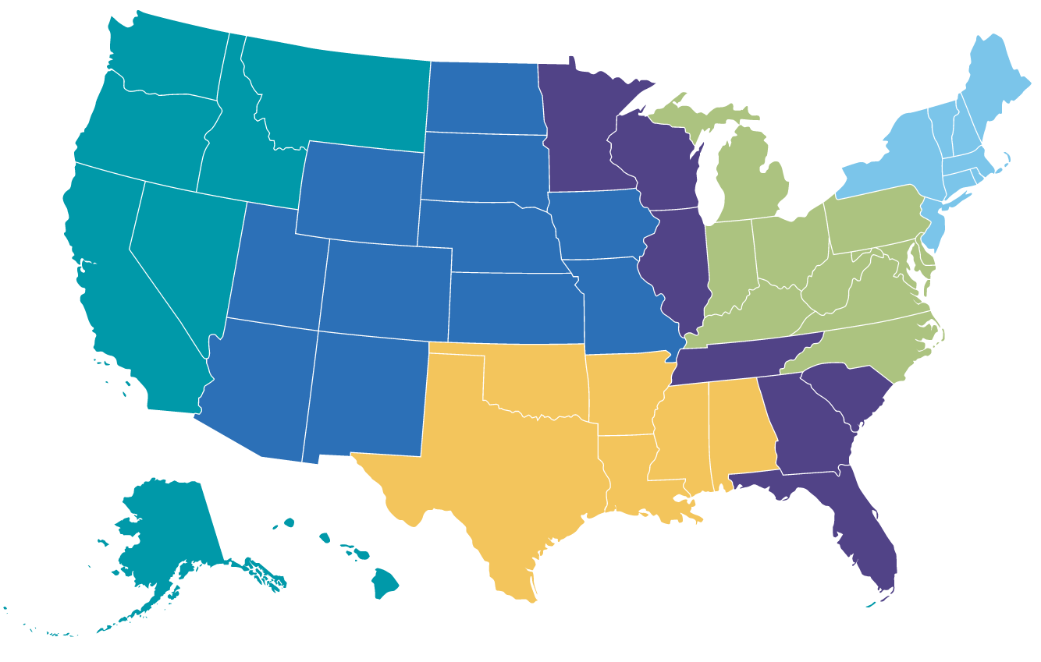
US Commercial footprint after full approvals
6 Field Medical Directors
1 Medical Resources Director
~60 Oncology Account Managers
6 Regional Sales Directors
3 Field Reimbursement Liaisons
12 Marketing, Access, and Comm Ops
Map is a representation. Territory alignment to be finalized prior to FDA approval.
Star represents home-base location of Medical Affairs Team.

Slide 29
Thank You!
CONTACT INFO:
Elevar Therapeutics
1 Bridge Plaza N Ste 850
Fort Lee, NJ 07024
U.S.A.
© 2024 Elevar Therapeutics, Inc. All Rights Reserved.

